Slide 1
Hobbyists
Give your hobby a new wing

Slide 2
Hobbyists
Team
Team Members
Suraiya Hasan (190042107)
Labiba Farah (190042118)
MD Mohaymen Ul Anam (190042142)
Supervisor
Shafkat Rahman Farabi

Slide 3
CONTENTS OF THE PRESENTATION
01
02
Introduction
Motivation
03
04
Key Features
Future Scope
05
06
Technologies
Project Timeline
01

Slide 4
INTRODUCTION
02
Online platform to explore hobbies.
Hobby-based quiz & solving puzzles (trivia quiz, timer quiz, puzzle solve).
A wide range of hobby selection.
Personalized feed based on their preference.

Slide 5
MOTIVATION
03
Existing similar applications lacks the enjoyment of learning with games. (E.g. “HobbyTwin”,’’Hobbynity”)
Lacks learning according to personal preference instead of mentor supervision (“Hobify”, “ipassio”)
To make a single platform to be facilitate to communicate with others, play games.
Engaging platform
Learning in an efficient way.

Slide 6





KEY FEATURES
04
Trivia Quiz
Profile Creation
?
Finding new Hobby
Hobby Selection
Blog Writing
Fun Fact notification
Exploring Article
Reading blogs with YouTube Video

Slide 7
FUTURE SCOPE
05
E-commerce site for hobby items.
Different server for social communication among similar hobbyists.

Slide 8
TECHNOLOGIES
06
React JS
Node JS
MongoDB
ExpressJS
For version control: GitHub

Slide 9
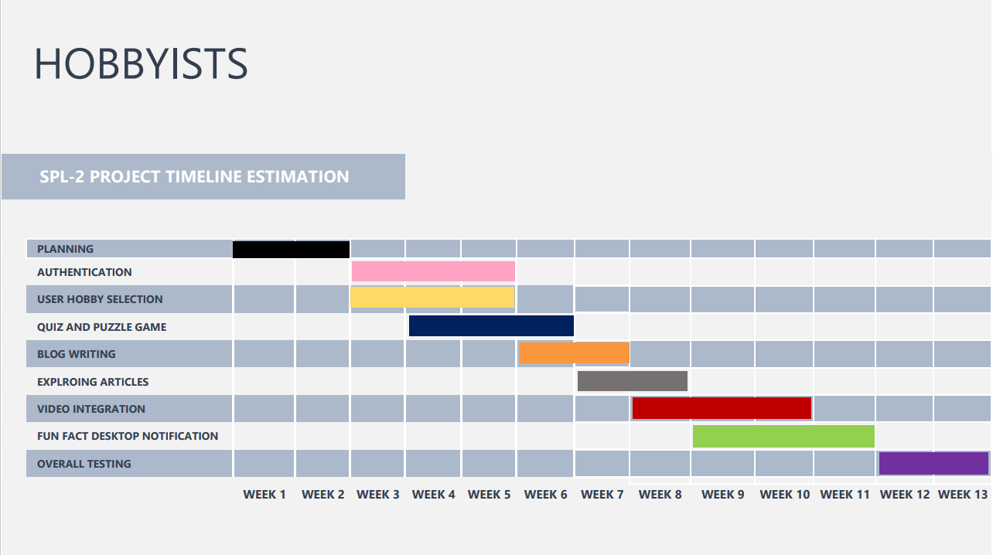
PROJECT TIMELINE
07

Slide 10
THANK YOU FOR BEING WITH US!
WE ARE NOW OPEN FOR QUESTIONS

